Slide 1
An Integrated QFD- Fuzzy Cognitive Map-MCGP-u Approach for Supplier Selection Problem
Keywords: Quality function deployment, neural network, fuzzy cognitive map, multi-criteria goal programming

Slide 2
Quality Function Deployment
WHAT: Customer requirements
Technical
Commercial
Strategic
HOW: Supplier Criteria

Slide 3
Inter-relationships between HOWs’
defuzzification
Initial weight matrix Wo
HOWs’
WHATs’
Relationship between HOWs’ and WHATs’
Importance of WHATs’
average
Weights of HOWs’
Concept state vector Ao

Slide 4
 | Importance of WHATs’ | HOWs’ WHATs’ | Price | Quality | Supplier Profile | Delivery Time
Technical requirements | 7.67 | Technical service | 7 | 8 | 3 | 6
Commer-cial requirements | 8.17 | Quantity discount | 6 | 1 | 2 | 0.33
Strategic requirements | 6.16 | Performance history | 0.83 | 2.67 | 8 | 3.33
 | 7.33 | Transportation | 2 | 1.5 | 0.83 | 7
Weights of HOWs’ |  |  | 122.48 | 96.97 | 94.71 | 120.54
Normalized Weights of HOWs’ (A_{i}) |  |  | 0.2818 | 0.2231 | 0.2179 | 0.2773

Slide 5
Defuzzification (method of centroid)
Interrelationship of supplier profile and price
Z (1)
PL (3)
PM (2)
Centroid=0.2857

Slide 6
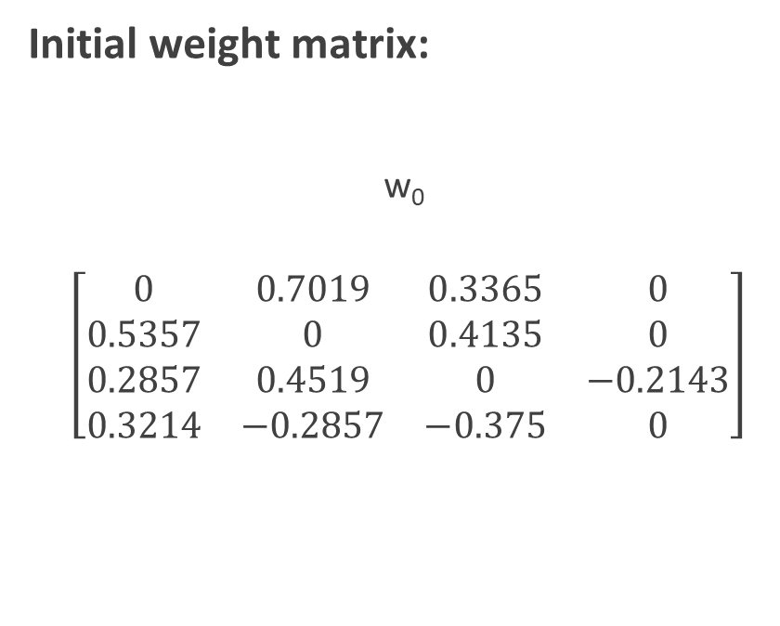

Before iteration
Initial concept state vector:
A₀
$$\left[\begin{matrix}0.2818 \\ 0.2231 \\ 0.2179 \\ 0.2773\end{matrix}\right]$$
Initial weight matrix:
w₀
$$\left[\begin{matrix}0 & 0.7019 & 0.3365 & 0 \\ 0.5357 & 0 & 0.4135 & 0 \\ 0.2857 & 0.4519 & 0 & −0.2143 \\ 0.3214 & −0.2857 & −0.375 & 0\end{matrix}\right]$$

Slide 7
Fuzzy Cognitive Map
Price
-0.3214
Delivery time
0.2818
Supplier evaluation
0.2773
0.7019
0.5357
-0.375
-0.2143
0.2231
0.2179
0.2857
-0.2857
0.3365
Supplier Profile
Quality
0.4135
0.4519

Slide 8
Non-linear Hebbian Algorithm
Updating the weight matrix
Calculating the weighted input
Passing the input through an activation function
w_{ij}^{(k+1)} = ɣw_{ij}^{(k)} + η_{k}A_{i}^{(k)} [ A_{j}^{(k)} –sgn(w_{ij}^{(k)}) w_{ij}^{(k)}A_{i}^{(k)}]
A^{(k)} + Σ𝑨^{(𝒌)}.𝒘^{(𝒌)}
f(x)=$\frac{1}{1+e^{−mx}}$
f(x)=1/(1+𝑒^(−𝑚𝑥) ⁾
Checking the error of prediction
|A_{i}^{(k+1)-} A_{i}^{(k)}| < e

Slide 9


After Reaching Steady State
A
$$\left[\begin{matrix}0.7061 \\ 0.7030 \\ 0.6906 \\ 0.6266\end{matrix}\right]$$
W
$$\left[\begin{matrix}0 & 0.1546 & 0.0846 & 0 \\ 0.1232 & 0 & 0.0991 & 0 \\ 0.0753 & 0.1067 & 0 & −0.0279 \\ 0.0484 & −0.0414 & −0.0599 & 0\end{matrix}\right]$$

Slide 10
Graph of Concept State Vector at each iteration

Slide 11
MCGP-u Optimization Model
Objective Function:
Minimize = 0.7061 (d₁⁻ + f₁⁻) + 0.7030 (d₂⁻ + f₂⁻) + 0.6906 (d₃⁻ + f₃⁻) + 0.6266 (d₄⁻ + f₄⁻)

Slide 12


Constraints
8S₁ + 7S₂ + 9S₃ + 10S₄ + 10S₅ + 10S₆ + 8S₇ - d₁⁺ + d₁⁻ = y₁ …...(1)
1 ≤ y₁ ≤ 10 …….(2)
λ₁ = $\frac{y_{1}−1}{10−1}$ …….(3)
λ₁ ₊ f₁⁻ =1 .......(4)
10S₁ + 8S₂ + 10S₃ + 10S₄ + 10S₅ + 10S₆ + 9S₇ – d₂⁺ + d₂⁻ = y₂ ……(5)
1 ≤ y₂ ≤ 10 …….(6)
λ₂ = $\frac{y_{2}−1}{10−1}$ ……...(7)
λ₂ ₊ f₂⁻ =1 ……..(8)

Slide 13


Constraints
7S₁ + 8S₂ + 9S₃ + 8S₄ + 10S₅ + 9S₆ + 8S₇ – d₃⁺ + d₃⁻ = y₃ .....(9)
1 ≤ y₃ ≤ 10 …….(10)
λ₃ = $\frac{y_{3}−1}{10−1}$ …….(11)
λ₃ ₊ f₃⁻ =1 …….(12)
8S₁ + 10S₂ + 9S₃ + 7S₄ + 9S₅ + 9S₆ + 10S₇ – d₄⁺ + d₄⁻ = y₄ ….(13)
1 ≤ y₄ ≤ 10 ……(14)
λ₄ = $\frac{y_{4}−1}{10−1}$ …….(15)
λ₄ ₊ f₄⁻ =1 ……(16)

Slide 14
Constraints
Other Constraints:
S₁ + S₂ + S₃+ S₄ + S₅ + S₆ + S₇ = 1 …..(17)
S_{j} € {0, 1} where j = 1,2……7 ………(18)
y_{i} , d_{i}⁺, d_{i}⁻, λ_{i} , f_{i}⁻ ≥ 0 where, i = 1,2….4 ……..(19)

Slide 15
Solution
Objective Function Value= 0.0696
S₅ =1
S₁ = S₂ = S₃ = S₄ = S₆ = S₇ =0

Slide 16
Solution
Criteria | Variables | Values | Variables | Values
Price | y₁ | 10 | λ₁ | 1
Quality | y₂ | 10 | λ₂ | 1
Supplier Profile | y₃ | 10 | λ₃ | 1
Delivery time | y₄ | 9 | λ₄ | 0.89

Slide 17

Selecting Multiple Suppliers
$\sum_{i=1}^{n}{\text{Sn} }$= m
While $\sum_{i=1}^{n}{\text{Sn} }=2,$
$\text{S}\text{1 = }\text{S}\text{2 =1, }\text{S}\text{3 = }\text{S}\text{4 = }\text{S}\text{5 = }\text{S}\text{6 =}\text{S}\text{7 = 0}$
While $\sum_{i=1}^{n}{\text{Sn} }=3,$
S1 = S2 = S4 =1, = S3 = S5 = S6 =S7 = 0

